Slide 1
PSP 2 Capitulo 10 software Design
Juan Alberto Gutiérrez canto
Matricula: 24400063
Id 94419

Slide 2
10 software design
Design quelity has two parts: the quality has two parts:
Quality of the design content.
Queality of the design representation.
A poor representation can also make the design so hard to understand that its problems will not be recognized unit implementation or even later.
Framework in the object-oriented design(OOD)
Sustitute either of the words procedure or función for the words class, method and object.

Slide 3
10.1 the design Process
You generaly start a design by:
defining the prouduct´s purpuse
Gathering relevant data
Producing an overview design
Filling in the details
These steps are not isolated sequential task, however:
They are cooperative
Parallel activities
Design involves Discovery and invention, and frecuently requires intuitive leaps from one abstraction level to another.

Slide 4
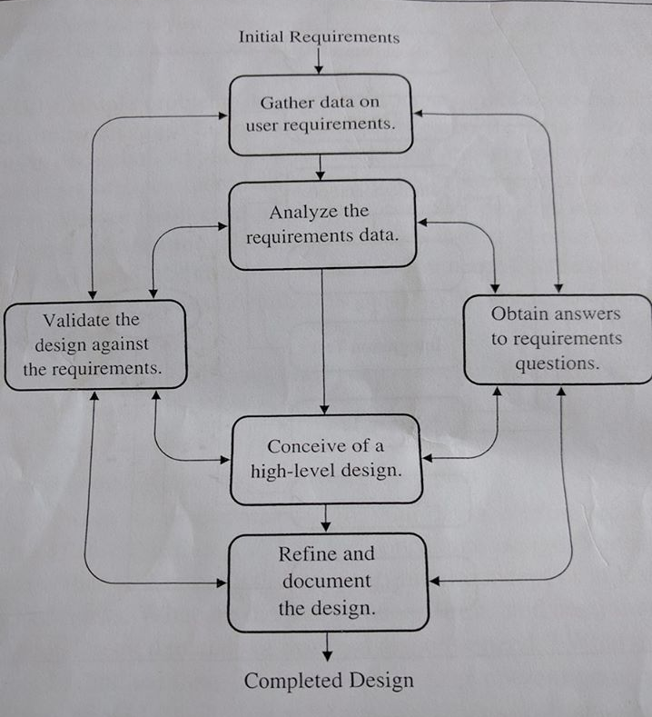
10.1.1 Design as a learning process
The design thus there will likely be many feedback loops and iterative cycles.
In the design steps, the changes enormously complicate the design process.
The users defined new need, the designers make changes, and the implementers code and fix defects.

Slide 5
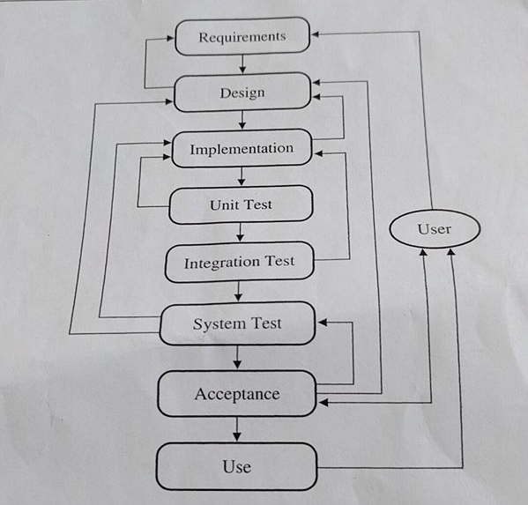
10.1.2 Freezing the design
Every new exposure leads to new knowledge, new ideas, and more changes.
The tricky problem for the developers is to trucate this learning process at just the right point so that a suitable product can be delivered in a reasonable time and at an affordable cost.
The PSP design process can help you make accurate plans and proposed quality products.

Slide 6
9.1.2 the conceptual design
Focuse on the hight- level issues unit you know enought to produce the overall conceptual design.
Complete and document the conceptual design.
Now make and document your development plan.
An immediate objective is to test the conceptual design.
Satisfafield yourself that th conceptual design is solid, you can begin to focues on details.

Slide 7
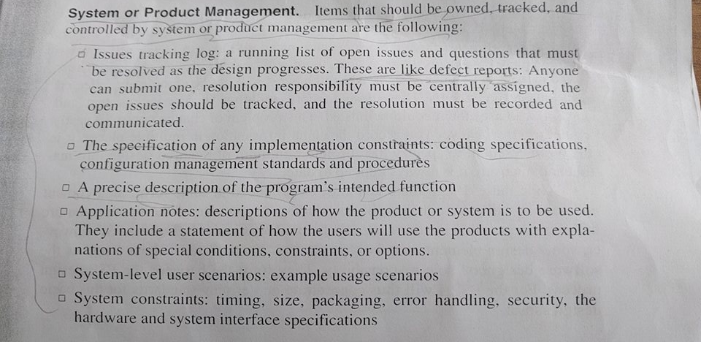
10.2 Design quality

Slide 8
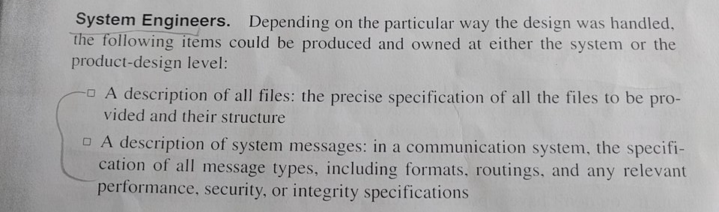
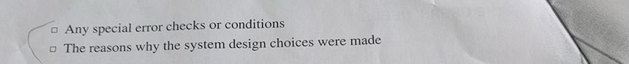
10.2 Design quality

Slide 9

10.2 Design quality
IBM
During design 1.5
Prior coding 1
During coding 1.5
Prior test 10
During test 60
In use 100

Slide 10
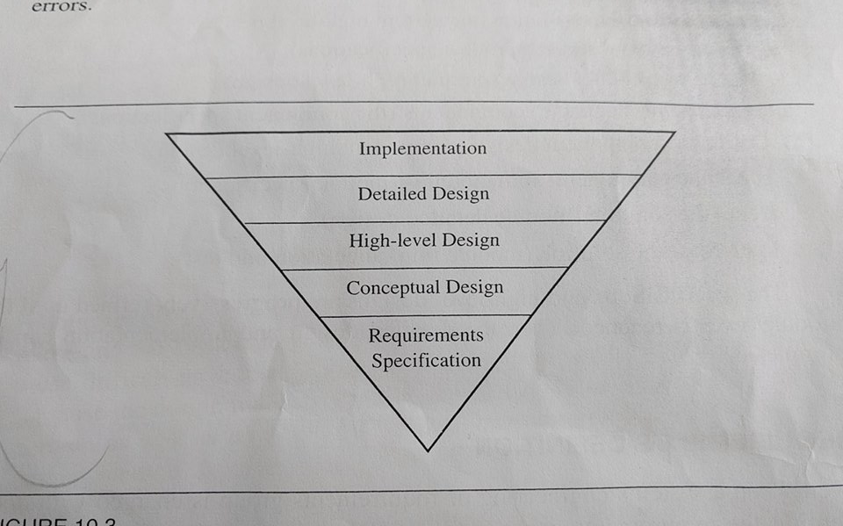
10.2 Design quality

